Slide 1
Using Intervention Mapping to Adapt Evidence-Based Interventions: IM Adapt with Linda Highfield, Marieke A. Hartman, Patricia Dolan Mullen, and Joanne N. Leerlooijer

Slide 2
Overview
Because of the importance of a balance between fidelity to original program design and adaptation to help an intervention better suit a new setting, changes to EBIs should be undertaken systematically with an eye to retention of the critical elements that made the program effective in the first place

Slide 3
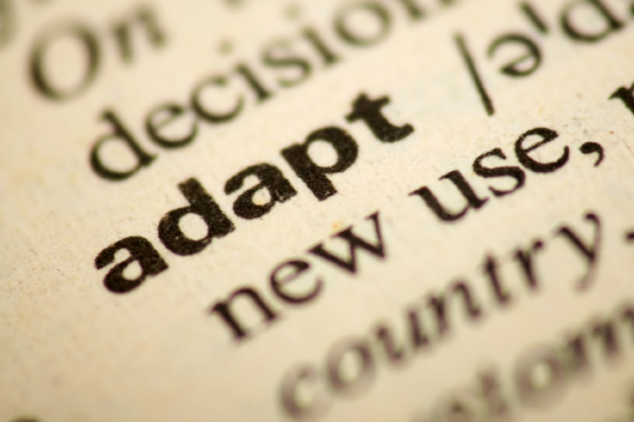
Tasks for IM Adapt
Conduct a needs assessment, and develop logic models for the problem and for change
Search for evidence-based interventions (EBIs)
Assess fit and plan adaptation
Make adaptations
Plan for implementation
Plan for evaluation

Slide 4
Adapting an EBI
INSERT FIGURE 10.1 HERE
Figure 10.1

Slide 5
Task 1: Conduct a Needs Assessment, Assess Organizational Capacity, and Create Logic Models
Conduct a needs assessment for the new site or population to develop a logic model of the problem
Develop a logic model of change
What needs to change as a result of the program?
Assess organizational capacity
Does the mission of the organization coincide with the goals of the intervention?
What budget is available for this project?
What is the organization’s readiness for implementing this program?

Slide 6
Logic Model of the Problem
INSERT FIGURE 10.2 HERE
Figure 10.2

Slide 7
Logic Model of Change
INSERT FIGURE 10.3 HERE
Figure 10.3

Slide 8
Task 2: Search for Evidence-based Interventions (EBIs)
Search for an EBI
Literature reviews
Websites for full EBIs
Websites for general intervention strategies
Judge basic fit to creat a “short list” of interventions to carry forward to Step 3
Health problem and health promoting behavior fit
Priority population fit
Organizational capacitiy fit

Slide 9
Task 3: Assess Fit and Plan Adaptation
Make final decision about which program to implement
More detailed judgement of fit for each program
Behavioral and environmental fit
Change methods and determinants fit
Delivery fit, design features, and cultural fit
Consider essential program elements and how to retain them
List adaptations needed

Slide 10
Task 4: Make Adaptations
Prepare design documents for adaptation
If proposed changes include additional determinants or change method, may need to prepare a “minimatrix”
Pretest adapted materials
Produce final adaptations

Slide 11
Task 5: Plan for Implementation
Identify implementers, behaviors, and outcomes
Delivered to whom? By whom? When? How much?
Develop implementation and maintenance scope, sequence, and instructions
Plan activities to motivate and train implementers
E.g., trainings, consultation, and technical support activities

Slide 12
Task 6: Plan for Evaluation
An overriding purpose to evaluating an adapted EBI is to determine whether the intervention achieves the same results in the new setting with the changes that have been made (effect evaluation)
Write effect and process evaluation questions
Choose indicators and measures
Choose an evaluation design
Plan data collection, analysis, and reporting

Slide 13
Case Study
Adapting an EBI to Enhance Mammography Screening among African American women

Slide 14
Task 1: Conduct a Needs Assessment, Assess Organizational Capacity, and Create Logic Models
African American women face disparities in mammography rates and mortality rates from breast cancer compared to other racial/ethnic groups in Houston, TX
Among women with mammogram appointments, African American women miss appointments at a higher rate

Slide 15
Planning Group
A local hospital-based charity organization
Breast cancer provider organizations
Local breast health collaborative
Local school of public health
They conducted:
A literature review
Local data collection
An organizational capacity review

Slide 16
Logic Model of the Problem
INSERT FIGURE 10.5 HERE
Figure 10.5

Slide 17
Logic Model of Change
INSERT FIGURE 10.6 HERE
Figure 10.6

Slide 18
Task 2: Search for Evidence-based Interventions (EBIs)
Searched for an EBI
Looked at Community Guide
Searched for a program using RTIPS
Found articles on three additional programs
Judged basic fit to creat a “short list”
Identified a telephone counseling program
Breast Cancer Screening among Non-adherent Women (Lipkus et al, 2000)
Lipkus, I. M., Rimer, B. K., Halabi, S., & Strigo, T. S. (2000). Can tailored interventions increase mammography use among HMO women? American Journal of Preventive Medicine, 18(1), 1–10.

Slide 19
Task 3: Assess Fit and Plan Adaptation
The planning group reviewed the program manual (implementation instructions and telephone counseling scripts) to assess:
Behavioral and environmental fit
Need to adapt from mammogram in general to appointment keeping specifically
Change methods and determinants fit
Need to enhance determinants and change methods related to stage of change
Precontemplation/contemplation
Preparation/action
Need to include change methods of persuasion, cultural congruence, problem solving, modeling, and guided practice

Slide 20
Continued….
Delivery fit, design features, and cultural fit
Telephone delivery acceptable
Scripts for barriers did not target exact concerns of local African American women
Recommended active-listening framework for scripts to enhance rapport
Considered essential program elements and how to retain them

Slide 21
Task 4: Make Adaptations
Prepared design documents for adaptation
Noted the planned change
Described the program materials and activities in which change should be made
Wrote or edited messages to support the change

Slide 22
Partial Adaptation “To-Do List”
INSERT FIRST PAGE (or LEGIBLE PORTION) OF TABLE 10.3 HERE
Table 10.3

Slide 23
Example from Design Document
INSERT FIRST PAGE (or LEGIBLE PORTION) OF TABLE 10.4 HERE
Table 10.4

Slide 24
Pretesting and Producing Adapted Materials
Pretesting telephone counseling scripts
14 African American women worked in pairs to role-play the scripts (navigator/caller and patient roles)
Noted any script changes
Produced revised manual of barriers and foundational conversation scripts in hardcopy form
After an initial evaluation study, the manual was converted to computer-assisted scripts for use by a live navigator

Slide 25
Task 5: Plan for Implementation
Identified implementers as patient navigators or community health workers familiar with making reminder calls
Implementers would make standard reminder calls as well as protocol-driven, barrier-focused counseling calls to African American women already scheduled for a mammogram
Clinical partners would provide navigators with space and access to appointment records
Specified implementation outcome
At least 100 standard reminder calls and 100 EBI calls in 12 months

Slide 26
Continued…
Scope of the EBI was one completed call per woman
Assessment of stage
Query regarding barriers
Solutions to barriers based on barrier scripts
Active listening the ‘glue’ for moving conversations forward
Motivating and training implementers
Developed training manual with scripts for opening, moving, and closing conversations, and barrier scripts
Training sessions with informal role-play practice to enhance implementers’ self-efficacy, outcome expectations and skills

Slide 27
Task 6: Plan for Evaluation
Evaluation aims:
Determine effectiveness of the adapted EBI to improve appointment keeping for mammography in African American women
Describe the processes of implementation of the adapted EBI in a practice setting

Slide 28
Effect Evaluation Questions
What was the effectiveness in decreasing appointment ‘no-show’ rates in the new setting?
How did the effectiveness of the adapted EBI in improving appointment-keeping compare to the effectiveness of the original EBI in improving mammography rates among non-adherent women?

Slide 29
Process Evaluation Questions
Was the adapted EBI delivered to the intended population?
Did the implementers follow the protocol?
What barriers were discussed in the phone calls?
Did women who received the adapted EBI find it helpful and acceptable?
What problems occurred during implementation of the adapted EBI?

Slide 30
Indicators and Measures
Effectiveness
Kept and missed appointments obtained from clinical partner’s electronic database
Implementation fidelity
Monitored intervention phone calls and compared to protocol
Site visits to clinical partner
Post-intervention phone calls to randomly selected patients receiving the intervention
Assessed perception of EBI calls
Systems barriers encountered
Recommended improvements to the program

Slide 31
Evaluation Design
Random assignment was not feasible
Assigned contacted women to usual care or adapted EBI in sequential groups of 50 patients
Enrolled African American women ages 35-64 years, uninsured, income < 200% federal poverty level, with an upcoming mammogram appointment
Identified eligible patients from electronic scheduling records

Slide 32
Project Outcomes and Current Status
The evaluation for this project was completed and the results were used to acquire funding for a larger implementation of the adapted EBI
Effectiveness results were in range with results from the original EBI evaluation
Women were approached at 41 mammography sites in 8 counties
Participants reported positive interactions with navigators and reported numerous things about the phone call that helped them attend their appointment

Slide 33
Summary
IM Adapt comprises 6 key tasks:
Conduct a needs assessment, and develop logic models for the problem and for change
Search for evidence-based interventions (EBIs)
Assess fit and plan adaptation
Make adaptations
Plan for implementation
Plan for evaluation

Slide 34
Questions?

